Slide 1
Mock Project - MCU
Team 2

Slide 2




Our Team
CuongNQ26
DangNTH3
HuyNV37
DungLM7
SonLD14
NamNH123

Slide 3




Requirement
Boot program
Used to load and start your Application
Design and Implement an application using Bootloader
Two firmwares
With two memory location on Flash memory
Firmware 1: Blink led
Firmware 2: Read ADC
Use Button to switch firmwares

Slide 4
Introduction to Bootloader

Slide 5
What is Bootloader?
A bootloader is an application whose primary objective is to upgrade/modify system software without the intervention of specialized firmware upgrade tools. Bootloaders can have many functionalities, but it's mainly used to manage the application.

Slide 6
How it works
Reset
Bootloader
Application

Slide 7
Why do we need to use it?
Update Firmware
Easy to update firmware remotely via wireless network
Security
Easy to use code to check firmware before loading it to avoid hackers

Slide 8
Project Design

Slide 9
Project Design
Project
Bootloader Handle
Main Application
Backup Application
Receive and Parse SREC Data

Slide 10
Coding Structure
Main
Middleware
Driver

Slide 11
Bootloader
…
Write firmwares into the memory
After reset, PC jumps to Bootloader Firmware
+ Press Button SW1, the program jumps to Main Application
+ Press Button SW2, the program jumps to Backup Application
Backup
0x0003.E.800
…
Main
Click SW1
Main
Reset
0x0003.B000
…
Bootloader
Backup
Click SW2
Bootloader
0x0000.0000

Slide 12
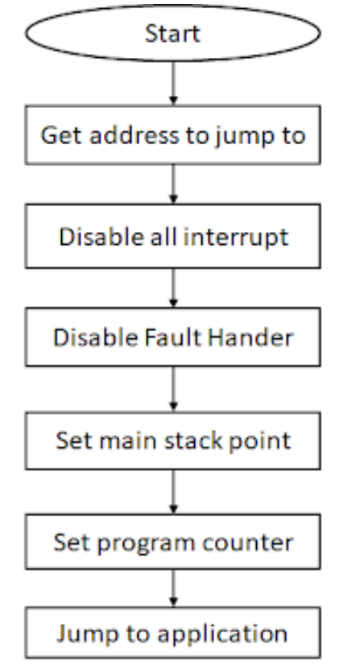
Bootloader
How to build a Boatloader program

Slide 13
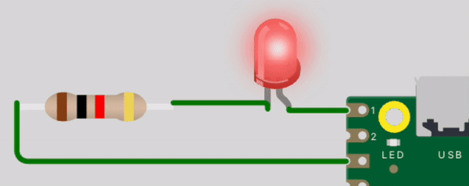
Firmware 1 – Main Application
Blink Led by using Button (External Interrupt)
Press Button SW1: Both LED1 and LED2 blink with the cycle T = 200ms
Press Button SW2: LED1 and LED2 blink one after another with the cycle T = 100ms
Button
KL46 MCU
LED1
LED2

Slide 14

Firmware 2 - Backup
Read Light Sensor by using ADC
Send a command (0x55) from PC to MCU, get 10 values of sensor.
PC
KL46 MCU
Light Sensor
0x55
10 times of data

Slide 15
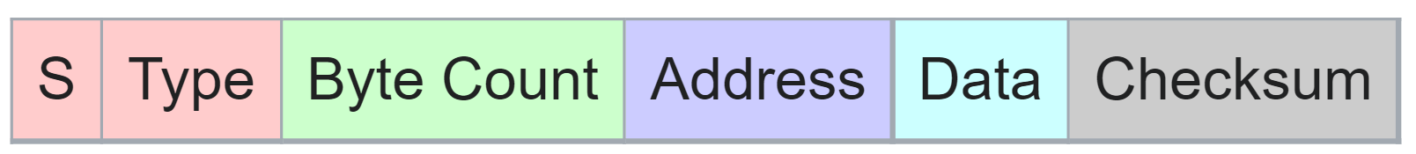
Receive and Parse SREC
SREC file format
SREC file format
Output

Slide 16
Receive and Parse SREC
Procedure to get output data of each application
Rebuild All
Parse SREC
Modify *icf file
An SREC file with a new address
Output Data

Slide 17
Run
&
Result

Slide 18
Work Evaluation
Member | Work Assigment | Grade
Cường | SREC, Timer, Slide | 3
Dũng | UART, Main, Presentation | 2
Đăng | Driver, Clock, Main | 5
Huy | SREC, Flash, Main | 5
Sơn | Firmware 2, Main | 4
Nam | Firmware 1, Button | 1
5: Very good
4: Good
3: Complete
2. Incomplete
1. Bad

Slide 19



Đội ngũ của chúng tôi
THÙY DUNG
Giám đốc Điều hành
LÊ BÍCH NHƯ
Giám đốc Vận hành
PHẠM HỮU TRỌNG
Giám đốc Sản phẩm

